Slide 1

Design Optimization of Coil Springs: Problem Statement and Formulation

Slide 2
GROUP MEMBERS Group Name: Fusion Beast
Divyanshi Pandey 20226055 ME
Isha Jaiswal 20226067 ME
Divyanshi 20226054 ME

Slide 3

INTRODUCTION
Welcome to the presentation on the Design Optimization of Coil Springs.
Coil springs are crucial components in various engineering applications, including automotive, aerospace, and industrial machinery.
This presentation focuses on formulating and optimizing the design of coil springs to meet specific performance criteria efficiently.

Slide 4

Problem Statement
Problem Statement: Coil springs are used in numerous practical applications. Detailed methods for analyzing and designing such mechanical components have been developed over the years. The purpose of this project is to design a minimum mass spring (shown in Figure) to carry a given axial load (called tension-compression spring) without material failure and while satisfying two performance requirements: the spring must deflect by at least A and the frequency of surge waves must not be less than 00 (Hertz, Hz).
Objective: Achieve an optimal balance between stiffness, strength, weight, and manufacturing cost.
Challenges: Balancing conflicting objectives, ensuring manufacturability, and addressing dynamic loading conditions.

Slide 5

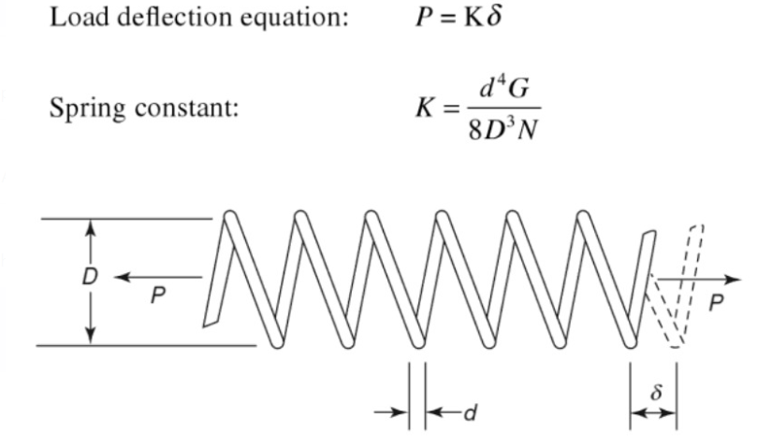

Slide 6

Formulation of Design Variables
- Wire Diameter (d): Represents the diameter of the wire used to form the coil.
- Coil Diameter (D): Indicates the overall diameter of the coil.
- Number of Coils (N): Determines the number of turns in the coil.

Slide 7
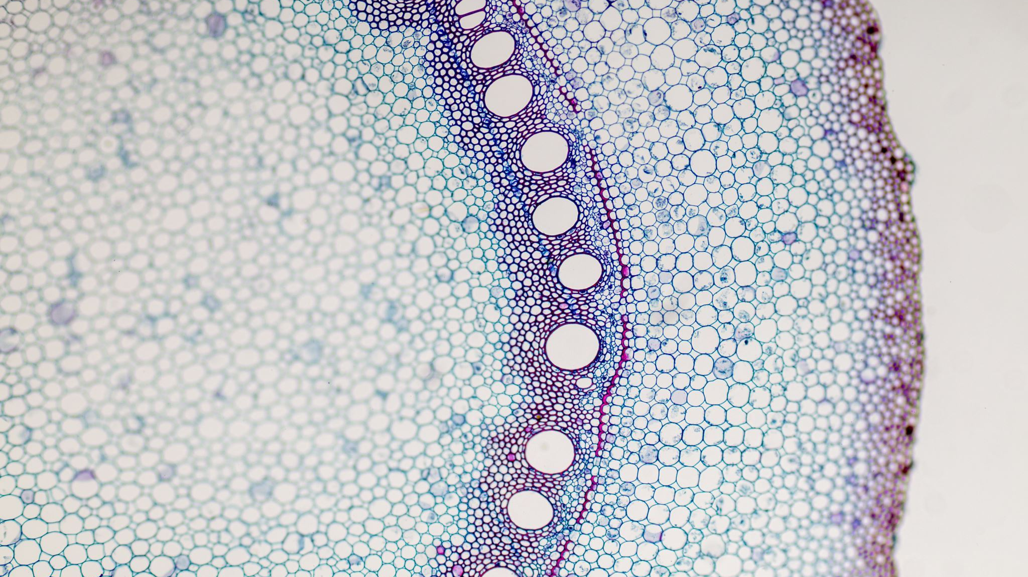
Optimization Approach
Objective: Utilize optimization algorithms to find the optimal values of design variables.
Methodology:
Define the objective function and constraints.
Choose an optimization algorithm (e.g., Gradient-based methods).
Conduct iterative optimization to find the best solution.
Validate the optimized design through simulation and testing

Slide 8
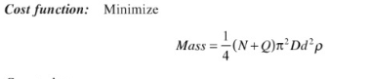
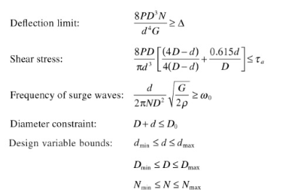
Cost Function
Constraints

Slide 9

Example Application: Automotive Suspension Spring
- Application: Designing a coil spring for automotive suspension.
Requirements:
- Stiffness for supporting vehicle weight.
- Durability to withstand road vibrations and shocks.
- Compact size to fit within the suspension system.
Optimization Goals:
- Maximize stiffness while minimizing weight and cost.
- Ensure manufacturability and reliability.

Slide 10

Results and Discussion
Results:
- Optimal values of design variables (d, D, N, L).
- Total cost of the optimized coil spring.
- Performance metrics (stiffness, strength, weight).
Discussion:
- Trade-offs between conflicting objectives.
- Sensitivity analysis to assess the impact of design variables.
- Future improvements and considerations for real-world implementation.

Slide 11

Conclusion
- Design optimization of coil springs is essential for achieving optimal performance and cost-effectiveness.
- Effective formulation of design variables, cost function, and constraints is crucial for successful optimization.

